Slide 1
Analyzing Fatal Road Accidents in the United States

Slide 2
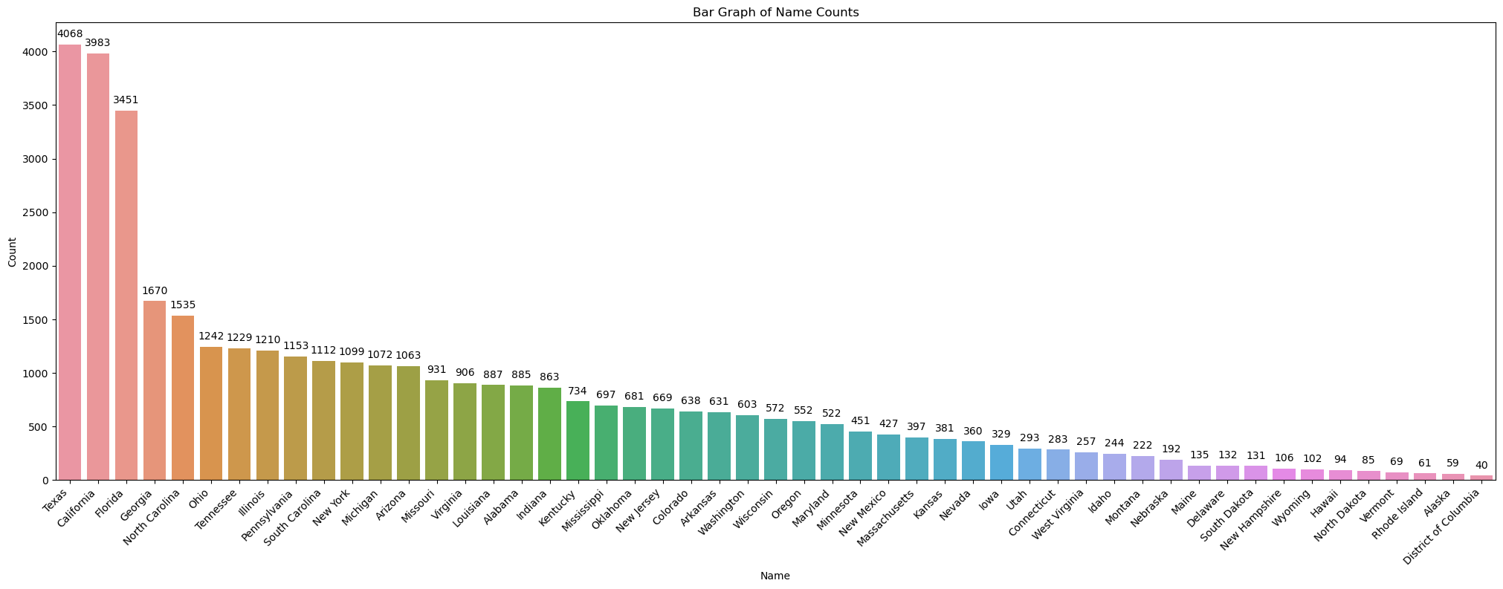
Problem Statement
Threat to Public Safety: Fatal accidents in the U.S. are a significant threat.
Objective: Investigate the relationship between fatal accidents and the day of the week.
Goals: Develop interventions for enhanced road safety.

Slide 3
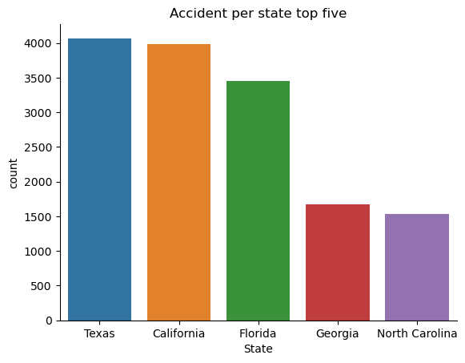
Data Wrangling
Dataset: Comprehensive data on fatal accidents in the U.S.
Process: Meticulous refinement for meaningful insights.
Key Steps:
Scrutiny of sample locations.
Dimensionality reduction for 2020 fatal vehicle incidents.
Handling null values with a forward-filling approach.

Slide 4
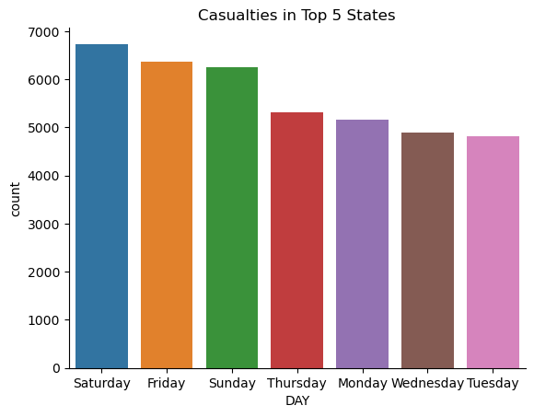
Exploratory Data Analysis (EDA)
Focus: Top five states - Texas, California, Florida, Georgia, and North Carolina.
Parameters: Geographical, incident details, and temporal information.
Measurements: Assess severity and frequency.
Correlations: Strong correlation between fatal accidents and weekends.
Conclusions: Actionable insights for interventions, considering unique characteristics of each state.

Slide 5
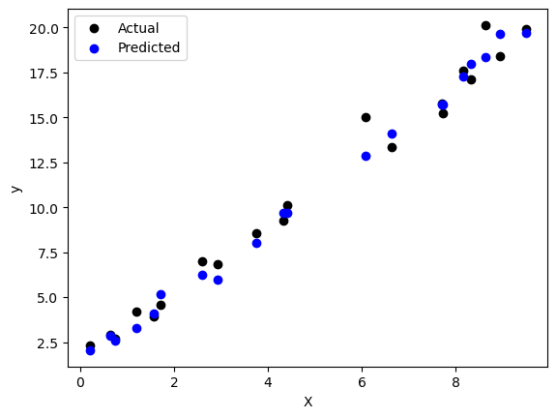
Model Selection
Models Considered:
RandomForestClassifier
Support Vector Machine (SVM)
RandomForestRegressor
Final Choice: RandomForestRegressor for commendable predictive accuracy.

Slide 6
Conclusion
Achievements:
Uncovered intricate relationships.
Refined dataset for evidence-based policies.
Provided actionable insights for interventions.
Selected RandomForestRegressor for optimal predictive accuracy.
Call to Action: Implement targeted interventions, raise public awareness, and let evidence-based policies guide towards a safer future on U.S. roadways.

